Slide 1
The divisions of the nervous system: central and peripheral (somatic and autonomic).
The structure and function of sensory, relay and motor neurons. The process of synaptic transmission, including reference to neurotransmitters, excitation and inhibition.
The function of the endocrine system: glands and hormones.
The fight or flight response including the role of adrenaline.
Localisation of function in the brain and hemispheric lateralisation: motor, somatosensory, visual, auditory and language centres; Broca’s and Wernicke’s areas, split brain research. Plasticity and functional recovery of the brain after trauma.
Ways of studying the brain: scanning techniques, including functional magnetic resonance imaging (fMRI); electroencephalogram (EEGs) and event-related potentials (ERPs); post-mortem examinations.
Biological rhythms: circadian, infradian and ultradian and the difference between these rhythms.
  The effect of endogenous pacemakers and exogenous zeitgebers on the sleep/wake cycle.

Slide 2
Hemispheric lateralisation
The human brain is divided into two hemispheres - left and right hemispheres. Lateralization of brain function means that there are certain mental processes that are mainly specialized to one side or the other.
Most mental functions are distributed across the hemispheres but there are specific processes that are specialized to one hemisphere. For example, both sides of the brain perform functions related to language. But in most people, grammar and vocabulary are localized to the left side of the brain, while understanding the emotional content of language is a function of the right hemisphere.

Slide 3
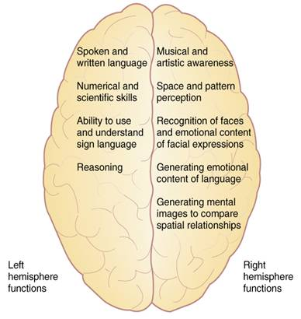

Slide 4
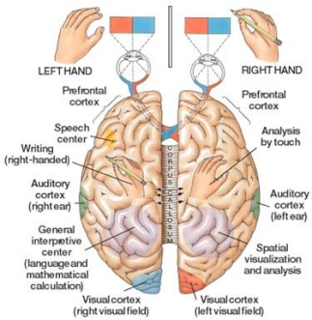

Slide 5
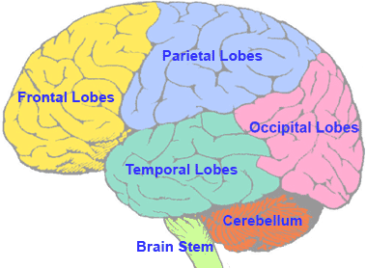
Lobes (clues)

Slide 6
motor
Almost all of behavior involves motor function, from talking to gesturing to walking. But even a simple movement like reaching out to pick up a glass of water can be a complex motor task to study. Not only does your brain have to figure out which muscles to contract and in which order to steer your hand to the glass, it also has to estimate the force needed to pick up the glass. Other factors, like how much water is in the glass and what material the glass is made from, also influence the brains calculations. Not surprisingly, there are many anatomical regions which are involved in motor function.

Slide 7
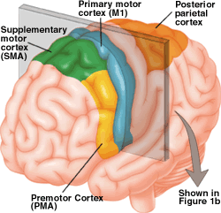
Primary motor Cortex

Slide 8
Primary Motor Cortex
The role of the primary motor cortex is to generate neural impulses that control the execution of movement. Signals from M1 cross the bodys midline to activate skeletal muscles on the opposite side of the body, meaning that the left hemisphere of the brain controls the right side of the body, and the right hemisphere controls the left side of the body. Every part of the body is represented in the primary motor cortex, and these representations are arranged somatotopically — the foot is next to the leg which is next to the trunk which is next to the arm and the hand. The amount of brain matter devoted to any particular body part represents the amount of control that the primary motor cortex has over that body part. For example, a lot of cortical space is required to control the complex movements of the hand and fingers, and these body parts have larger representations in M1 than the trunk or legs, whose muscle patterns are relatively simple.

Slide 9
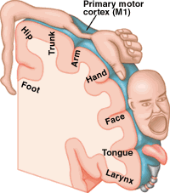

Slide 10
Somatosensory
Catch-all term to designate senses other than vision, hearing, balance, taste and smell. Receptors that could be designated "somatosensory" are distributed all over the body rather than concentrated at specific locations.

Slide 11
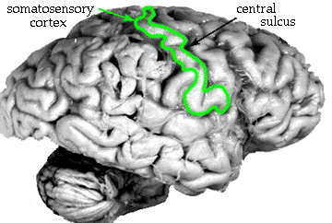

Slide 12
Somatosensory
The first modality is called discriminative touch, which includes touch, pressure, and vibration perception, and enables us to "read" raised letters with our fingertips, or describe the shape and texture of an object without seeing it. The second grouping is pain and temperature, which is just what it sounds like, and also includes the sensations of itch and tickle. The third modality is called proprioception, and includes receptors for what happens below the body surface: muscle stretch, joint position, tendon tension, etc. This modality primarily targets the cerebellum, which needs minute-by-minute feedback on what the muscles are doing.

Slide 13
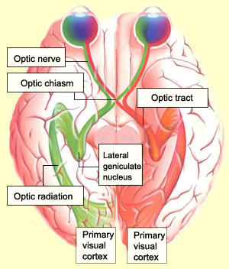
Visual (Occipital lobe)

Slide 14
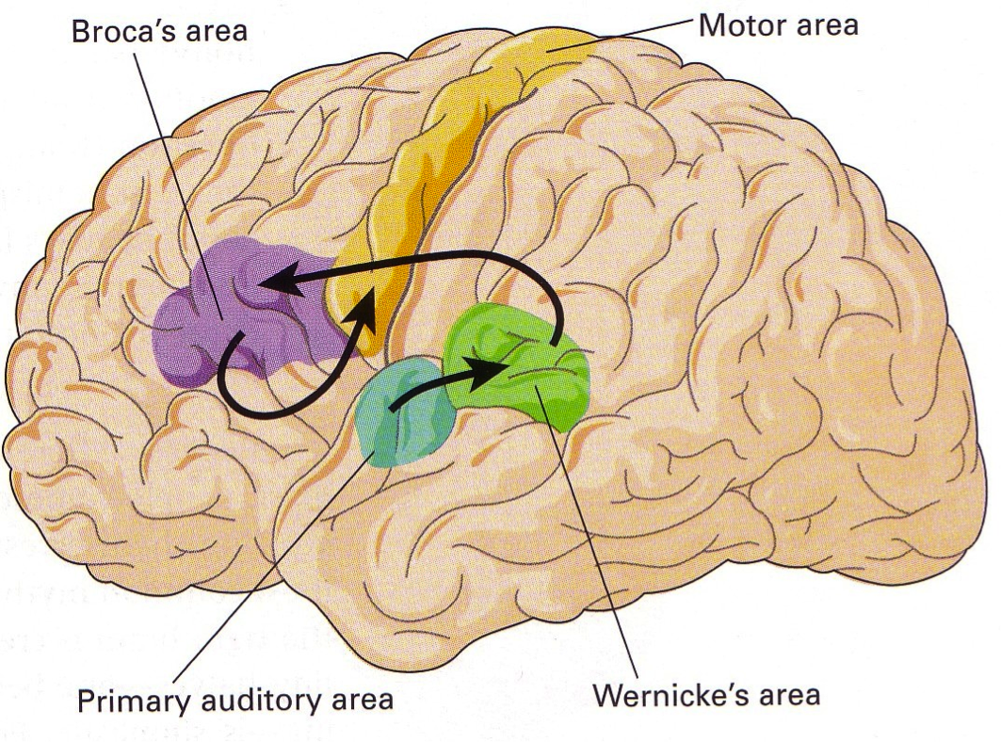
Auditory

Slide 15
Wernicke area
This area was first described in 1874 by German neurologist Carl Wernicke. The Wernicke area is located in the posterior third of the upper temporal convolution of the left hemisphere of the brain. Thus, it lies close to the auditory cortex. This area appears to be uniquely important for the comprehension of speech sounds and is considered to be the receptive language, or language comprehension, centre.
Damage to the temporal lobe may result in a language disorder known as Wernicke aphasia. An individual with Wernicke aphasia has difficulty understanding language; speech is typically fluent but is empty of content and characterized by circumlocutions, a high incidence of vague words like “thing,” and sometimes neologisms and senseless “word salad.”
[Credit: Encyclopædia Britannica, Inc.]

Slide 16
Language
A century and a half ago, French physician Pierre Paul Broca found that patients with damage to part of the brain’s frontal lobe were unable to speak more than a few words. Later dubbed Broca’s area, this region is believed to be critical for speech production and some aspects of language comprehension.
However, in recent years neuroscientists have observed activity in Broca’s area when people perform cognitive tasks that have nothing to do with language, such as solving math problems or holding information in working memory. Those findings have stimulated debate over whether Broca’s area is specific to language or plays a more general role in cognition.

Slide 18
Split brain research
Show through experiment.
Corpus Colosseum
https://www.youtube.com/watch?v=MZnyQewsB_Y

Slide 19
Split brain
Sperry’s research (1960’s and 1970’s) revealed that when the two hemispheres of the brain are disconnected, they become functionally separate. Studies of patients whose corpus callosum had been severed, disconnecting the left and right halves of the brain, revealed this insight. Click here for more on lateralisation and the procedures and findings of the experiments.
Watch this video for a demonstration of the experiments.
Neuro-myths
In an article entitled “Right Brained, Wrong Brained: How Caltech Neuroscience became a Buzzfeed Quiz” (Los Angeles Magazine, Feb 9th 2015), author Jason G. Goldman highlights the inappropriate use of Sperry’s research to suggest that people can be left or right brained. The idea that people can be categorised as being one or the other, to account for our strengths and weaknesses, is a neuro-myth. The article points about that the brain needs both sides to function but that both sides need the corpus callosum to communicate. The misreporting of the findings – and a human need to find ways to explain and predict our success and failures – seems to be responsible for the widespread misuse of this finding. The idea of right or left “brained-ness” is popular probably because it seems more scientific than horoscopes or out-dated personality classifications.
Follow this link for more about this myth.
“”The great pleasure and feeling in my right brain is more than my left brain can find the words to tell you.”

Slide 20
Plasticity and functional recovery of the brain after trauma.
Introduction
http://www.bbc.co.uk/news/health-35595086

Slide 21
What is Brain Plasticity?
Brain plasticity—also called neuroplasticity - is an odd term for most people, with the word "plastic" causing images of Tupperware or Saran Wrap to pop into your head. However, brain plasticity is a common term used by neuroscientists, referring to the brain's ability to change at any age – for better or worse. As you would imagine, this flexibility plays an incredibly important role in our brain development (or decline) and in shaping our distinct personalities.
How the Brain Changes
Brain plasticity science is the study of a physical process. Gray matter can actually shrink or thicken; neural connections can be forged and refined or weakened and severed. Changes in the physical brain manifest as changes in our abilities. For example, each time we learn a new dance step, it reflects a change in our physical brains: new "wires" (neural pathways) that give instructions to our bodies on how to perform the step. Each time we forget someone's name, it also reflects brain change— "wires“ that once connected to the memory have been degraded, or even severed. As these examples show, changes in the brain can result in improved skills (a new dance step) or a weakening of skills (a forgotten name)

Slide 22
Neuroplasticity
Neuroplasticity, also known as brain plasticity, is an umbrella term that describes lasting change to the brain throughout an animal's life course. The term gained prominence in the latter half of the 20th century, when new research showed many aspects of the brain remain changeable (or "plastic") even into adulthood. This notion contrasts with the previous scientific consensus that the brain develops during a critical period in early childhood, then remains relatively unchangeable (or "static") afterward. Neuroplastic change can occur at small scales, such as physical changes to individual neurons, or at whole-brain scales, such as cortical remapping in response to injury.[ Behavior, environmental stimuli, thought, and emotions may also cause neuroplastic change, which has significant implications for healthy development, learning, memory, and recovery from brain damage.
Neuroscientists distinguish synaptic plasticity, which refers to changes in how neurons connect to each other, from non-synaptic plasticity, which refers to changes in the neurons themselves.

Slide 23
Doidge
https://www.youtube.com/watch?v=ifYcE4-eI_s
Intense dedication is a hallmark of those who, all on their own, accomplish large-scale change in their brains. John Pepper, a South African now in his late seventies, was diagnosed in his thirties with the incurable, chronic, progressive neurodegenerative disease known as Parkinson’s. By all odds he should be immobile, if not dead, by now, but Pepper has fought his symptoms to a standstill by vigorous exercise carried out with ferocious determination and conscientious attention to detail. “Even as his unconscious ability to walk unravelled,” Doidge explains, “Pepper realized that if he analyzed how he walked and used his conscious mind to guide him, he could still do it. So he used a different part of his brain, the frontal lobes, and—like a child learning to walk—thought himself into efficient walking.”
http://www.macleans.ca/society/health/how-your-brain-heals-itself/

Slide 24
Draganski et al (2006) German medical students and revision
Luke and Georgi?

Slide 25
Treatment of brain damage Nudo group research on stroke recovery, Phillips (2006) case study of recovery from a coma after 19 years.
Veronica

Slide 26
Notes
Plasticity
How the Brain Changes
Brain plasticity science is the study of a physical process. Gray matter can actually shrink or thicken; neural connections can be forged and refined or weakened and severed. Changes in the physical brain manifest as changes in our abilities. For example, each time we learn a new dance step, it reflects a change in our physical brains: new "wires" (neural pathways) that give instructions to our bodies on how to perform the step. Each time we forget someone's name, it also reflects brain change— "wires“ that once connected to the memory have been degraded, or even severed. As these examples show, changes in the brain can result in improved skills (a new dance step) or a weakening of skills (a forgotten name)

Slide 27
Increased Brain Stimulation
Molly and Savanna

Slide 28
Axon Sprouting
Terry and Sam

Slide 29
Denervation supersensitivity
Axons that do a similar job to those that are damaged become more sensitive. This can have the negative effect of making the person more sensitive to aspects that they were not previously eg: ‘over’ sensitive to pain.

Slide 30
Functional recovery after Trauma
Factors effecting:
Perserverance
Lottie and Cameron

Slide 31
Physical stress exhaustion and Booze!
Esme And Olivia

Slide 32
Age and Gender
Niamh and Abi

Slide 33
Syllabus
The divisions of the nervous system: central and peripheral (somatic and autonomic).
The structure and function of sensory, relay and motor neurons. The process of synaptic transmission, including reference to neurotransmitters, excitation and inhibition.
The function of the endocrine system: glands and hormones.
The fight or flight response including the role of adrenaline.
Localisation of function in the brain and hemispheric lateralisation: motor, somatosensory, visual, auditory and language centres; Broca’s and Wernicke’s areas, split brain research. Plasticity and functional recovery of the brain after trauma.
Ways of studying the brain: scanning techniques, including functional magnetic resonance imaging (fMRI); electroencephalogram (EEGs) and event-related potentials (ERPs); post-mortem examinations.
Biological rhythms: circadian, infradian and ultradian and the difference between these rhythms.
  The effect of endogenous pacemakers and exogenous zeitgebers on the sleep/wake cycle.

Slide 34
Ways of studying the brain: scanning techniques, including functional magnetic resonance imaging (fMRI); electroencephalogram (EEGs) and event-related potentials (ERPs); post-mortem examinations.
https://youtu.be/MiL0wCZr0Mw

Slide 35
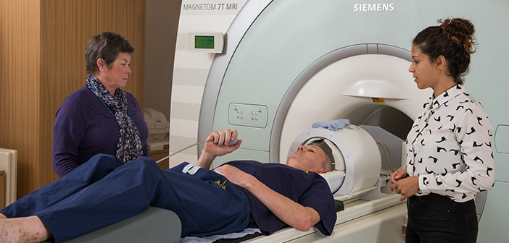
functional magnetic resonance imaging (fMRI)

Slide 36
FMRI (read)
FMRI is one of the most recently developed forms of neuroimaging but the idea underpinning the technique - inferring brain activity by measuring changes in blood flow - is not new. The following account of an experiment performed by the Italian scientist Angelo Mosso (left) can be found in William James’ The Principles of Psychology, published in 1890:
'The subject to be observed lay on a delicately balanced table which could tip downwards either at the head or the foot if the weight of either end were increased. The moment emotional or intellectual activity began in the subject, down went the balance at the head-end, in consequence of the redistribution of blood in his system…'

Slide 37
FMRI
The development of FMRI in the 1990s, generally credited to Seiji Ogawa and Ken Kwong, is the latest in long line of innovations, including positron emission tomography (PET) and near infrared spectroscopy (NIRS), which use blood flow and oxygen metabolism to infer brain activity. As a brain imaging technique FMRI has several significant advantages:
It is non-invasive and doesn’t involve radiation, making it safe for the subject.
It has excellent spatial and good temporal resolution.
It is easy for the experimenter to use.
The attractions of FMRI have made it a popular tool for imaging normal brain function – especially for psychologists. Over the last decade it has provided new insight to the investigation of how memories are formed, language, pain, learning and emotion to name but a few areas of research. FMRI is also being applied in clinical and commercial settings.

Slide 38
WHAT MRI MEASURES
The cylindrical tube of an MRI scanner houses a very powerful electro-magnet. A typical research scanner (such as the FMRIB Centre scanner) has a field strength of 3 teslas (T), about 50,000 times greater than the Earth’s field. The magnetic field inside the scanner affects the magnetic nuclei of atoms. Normally atomic nuclei are randomly oriented but under the influence of a magnetic field the nuclei become aligned with the direction of the field. The stronger the field the greater the degree of alignment. When pointing in the same direction, the tiny magnetic signals from individual nuclei add up coherently resulting in a signal that is large enough to measure. In FMRI it is the magnetic signal from hydrogen nuclei in water (H₂O) that is detected. The key to MRI is that the signal from hydrogen nuclei varies in strength depending on the surroundings. This provides a means of discriminating between grey matter, white matter and cerebral spinal fluid in structural images of the brain.

Slide 39
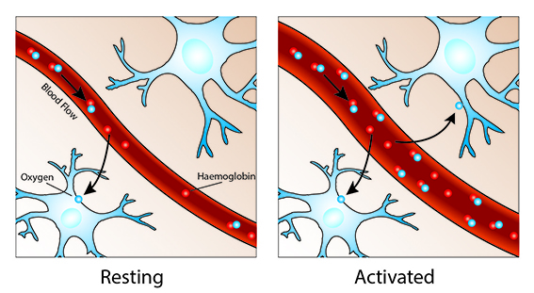
WHAT FMRI MEASURES
Oxygen is delivered to neurons by haemoglobin in capillary red blood cells. When neuronal activity increases there is an increased demand for oxygen and the local response is an increase in blood flow to regions of increased neural activity.
Haemoglobin is diamagnetic when oxygenated but paramagnetic when deoxygenated. This difference in magnetic properties leads to small differences in the MR signal of blood depending on the degree of oxygenation. Since blood oxygenation varies according to the levels of neural activity these differences can be used to detect brain activity. This form of MRI is known as blood oxygenation level dependent (BOLD) imaging.

Slide 40
One point to note is the direction of oxygenation change with increased activity. You might expect blood oxygenation to decrease with activation, but the reality is a little more complex. There is a momentary decrease in blood oxygenation immediately after neural activity increases, known as the “initial dip” in the haemodynamic response. This is followed by a period where the blood flow increases, not just to a level where oxygen demand is met, but overcompensating for the increased demand. This means the blood oxygenation actually increases following neural activation. The blood flow peaks after around 6 seconds and then falls back to baseline, often accompanied by a “post-stimulus undershoot”.

Slide 41
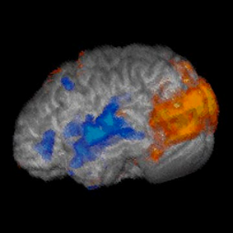
ACTIVATION MAPS
The image shown is the result of the simplest kind of FMRI experiment. While lying in the MRI scanner the subject watched a screen which alternated between showing a visual stimulus and being dark every 30 second. Meanwhile the MRI scanner tracked the signal throughout the brain. In brain areas responding to the visual stimulus you would expect the signal to go up and down as the stimulus is turned on and off, albeit blurred slightly by the delay in the blood flow response. The ‘activity’ in a voxel is defined as how closely the time-course of the signal from that voxel matches the expected time-course. Voxels whose signal corresponds tightly are given a high activation score, voxels showing no correlation have a low score and voxels showing the opposite (deactivation) are given a negative score. These can then be translated into activation maps.

Slide 42
Watch This.
https://www.youtube.com/watch?v=0uSYLy9itgg

Slide 43
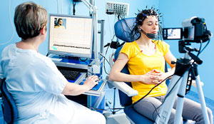
Electroencephalogram (EEGs)
An electroencephalogram (EEG) is a recording of brain activity.
During the test, small sensors are attached to the scalp to pick up the electrical signals produced when brain cells send messages to each other.
These signals are recorded by a machine and are looked at by a doctor later to see if they're unusual.
The EEG procedure is usually carried out by a highly trained specialist called a clinical neurophysiologist during a short visit to hospital.
https://www.youtube.com/watch?v=XMizSSOejg0

Slide 44
When an EEG is used
An EEG can be used to help diagnose and monitor a number of conditions affecting the brain.
It may help identify the cause of certain symptoms – such as seizures (fits) or memory problems – or find out more about a condition you've already been diagnosed with.
The main use of an EEG is to detect and investigate epilepsy, a condition that causes repeated seizures. An EEG will help your doctor identify the type of epilepsy you have, what may be triggering your seizures, and how best to treat you.
Less often, an EEG may be used to investigate other problems, such as dementia, head injuries, brain tumours, encephalitis (brain inflammation) and sleep disorders, such as obstructive sleep apnoea.

Slide 45
How an EEG is carried out
There are several different ways an EEG recording can be taken. The clinical neurophysiologist will explain the procedure to you and can answer any questions you have. You'll also be asked whether you give permission (consent) for the various parts of the test to be carried out.
Before the test starts, your scalp will be cleaned and about 20 small sensors called electrodes will be attached using a special glue or paste. These are connected by wires to an EEG recording machine.
Routine EEG recordings usually take 20 to 40 minutes, although a typical appointment will last about an hour, including some preparation time at the beginning and some time at the end. Other types of EEG recording may take longer.

Slide 46
Types of EEG
The main types of EEG are explained below.
Routine EEG
  A routine EEG recording lasts for about 20 to 40 minutes.
  During the test, you'll be asked to rest quietly and open or close your eyes from time to time. In most cases, you'll also be asked to breathe in and out deeply (known as hyperventilation) for a few minutes.
  At the end of the procedure a flashing light may be placed nearby to see if this affects your brain activity.
Sleep EEG or sleep-deprived EEG
  A sleep EEG is carried out while you're asleep. It may be used if a routine EEG doesn't give enough information, or to test for sleep disorders.
  In some cases, you may be asked to stay awake the night before the test to help ensure you can sleep while it's carried out. This is called a sleep-deprived EEG.
Ambulatory EEG
  An ambulatory EEG is where brain activity is recorded throughout the day and night over a period of one or more days. The electrodes will be attached to a small portable EEG recorder that can be clipped on to your clothing.
  You can continue with most of your normal daily activities while the recording is being taken, although you'll need to avoid getting the equipment wet.
Video telemetry
  Video telemetry, also known as video EEG, is a special type of EEG where you're filmed while a recording is taken. This can help provide more information about your brain activity.
  The test is usually carried out over a few days while staying in a purpose-built hospital suite.
  The EEG signals are transmitted wirelessly to a computer. The video is also recorded by the computer and kept under regular surveillance by trained staff.

Slide 47
Are there any risks or side effects?
The EEG procedure is painless, comfortable and generally very safe. No electricity is put into your body while it's carried out. Apart from having messy hair and possibly feeling a bit tired, you won't normally experience any after effects.
However, you may feel lightheaded and notice a tingling in your lips and fingers for a few minutes during the hyperventilation part of the test. Some people develop a mild rash where the electrodes were attached.
There's a very small risk you could have a seizure while the test is carried out, but you'll be closely monitored and help will be on hand in case this happens.

Slide 48
Event-related potentials (ERPs)
https://www.youtube.com/watch?v=PSoPsRPGjs4

Slide 49
If you feel queasy do not watch this
https://www.youtube.com/watch?v=jHxyP-nUhUY
Check out page 239 and note classic case study

Slide 50
Biological rhythms
Biological rhythms: circadian, infradian (more) and ultradian (less) and the difference between these rhythms.
  The effect of endogenous pacemakers and exogenous zeitgebers on the sleep/wake cycle.

Slide 51
Do you need to sleep?

Slide 52
Why we sleep.
Watch this for explanation of stages.
https://www.youtube.com/watch?v=fNlp0UMqUtM

Slide 53
Repair and Restoration
NREM (Non-rapid eye movement) sleep is important for restoring physiological functions, while REM sleep is essential in restoring mental functions.
Support for this theory is provided by research that shows periods of REM sleep increase following periods of sleep deprivation and strenuous physical activity. During sleep, the body also increases its rate of cell division and protein synthesis, further suggesting that repair and restoration occurs during sleeping periods.

Slide 54
Evolutionary Theory of Sleep
Evolutionary theory, also known as the adaptive theory of sleep, suggests that periods of activity and inactivity evolved as a means of conserving energy. According to this theory, all species have adapted to sleep during periods of time when wakefulness would be the most hazardous.
Support for this theory comes from comparative research of different animal species. Animals that have few natural predators, such as bears and lions, often sleep between 12 to 15 hours each day. On the other hand, animals that have many natural predators have only short periods of sleep, usually getting no more than 4 or 5 hours of sleep each day.

Slide 55
Information Consolidation
The information consolidation theory of sleep is based on cognitive research and suggests that people sleep in order to process information that has been acquired during the day. In addition to processing information from the day prior, this theory also argues that sleep allows the brain to prepare for the day to come.
Some research also suggests that sleep helps cement the things we have learned during the day into long-term memory. Support for this idea stems from a number of sleep deprivation studies demonstrating that a lack of sleep has a serious impact on the ability to recall and remember information.

Slide 56
What do you think.
????????????????????????????????????????????????????????????????????????????????????????????????????????????????????????????????????????????????????????????????????????????????????????????????????????????????????????????????????????????????????????????????????????????????????????????????????????????????????????????????????????????????????????????????????????

Slide 57
Can you sleep too much.
The sleep bank?
Some people need 4hrs others 10hrs - everyone is different. Falling asleep during the day = not enough sleep.
Not being able to sleep – Insomnia!
I don’t need sleep!

Slide 58
Biological rhythms
Biological rhythms: circadian, infradian and ultradian and the difference between these rhythms.
  The effect of endogenous pacemakers and exogenous zeitgebers on the sleep/wake cycle.

Slide 59
circadian
Sleep is regulated by two body systems:sleep/wake homeostasis and the circadian biological clock .
A body cycle that lasts 24 hours (or, literally translated, about a day). The sleep-wake cycle is an example of a circadian rhythm, although it only lasts 24 hours because it is reset by external zeitgebers (such as day light, meal times, and the clock). Research by Siffre (1975), in which he isolated himself in a cave away from natural light, found the human sleep-wake cycle to actually be around 24-25 hours.

Slide 60
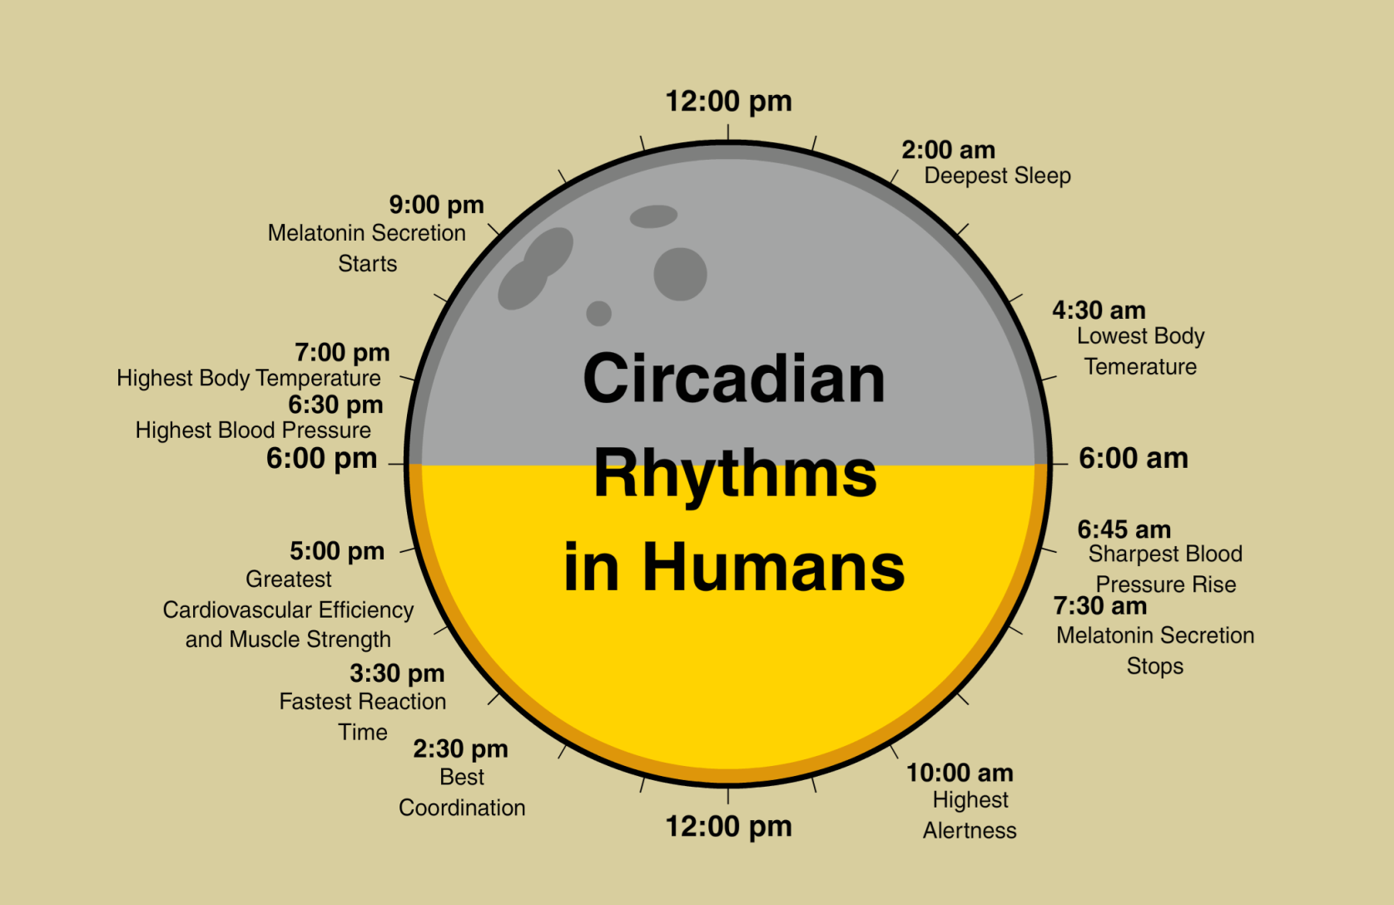

Slide 61
Research has found that circadian rhythms, in particular the sleep-wake cycle, are controlled by endogenous pacemakers that are influenced, or synchronized, by exogenous zeitgebers.

Slide 62
Endogenous pacemakers
Endogenous pacemakers are inbuilt biological clocks that regulate our behaviour, such as the sleep/wake cycle, stages of sleep and the menstrual cycle.

Slide 63
Exogenous zeitgebers
Exogenous Zeitgebers are external influences that have an effect upon the internal regulation of the body and reset the body's main pacemaker;

Slide 64
Exogenous zeitgebers

Slide 65
Endogenous pacemakers

Slide 67
The Supra-Chiasmatic Nucleus
The main endogenous pacemaker for the sleep-wake cycle is the SCN (supra-chiasmatic nucleus). Neurones project from the SCN to the pineal gland which releases melatonin to induce sleepiness.
Ralph et al (1990) investigated the role of the SCN in the sleep-wake cycle of hamsters. They removed the supra-chaismatic nuclei from a sample of mutant hamsters who had a natural sleep-wake of 21 hours, and transplanted them into the brains of non-mutant hamsters who had a natural sleep-wake cycle of 24 hours. The non-mutant hamsters changed to the 21 hour cycle of the mutant hamsters, showing that the SCN was the dominant endogenous pacemaker. Generalising from this study to human beings is problematic as there are clearly differences between hamsters and humans, however both are mammals and share broadly similar brain structures, although they do of course have differences with free-will, social interactions, and so on.

Slide 68
Note
Sifre (1975) was a speleologist (cave expert) who investigated the natural duration of his own sleep-wake cycle. He isolated himself from all daylight by hiding in a dark cave with only weak artificial light for 6 months. Siffre had no clock or any reference to time, however he did have verbal contact with the outside world. The findings were that his sleep-wake cycle settled naturally at around 25 hours, although sometimes it would range up to 48 hours. Siffre concluded that the absence of natural daylight allowed his biological clock to run at its natural rate, and that normally daylight acted as an exogenous zeitgeber to resynchronise the cycle. The study was, of course, a case study and cannot therefore be readily generalized to other people, however it has been repeated several times by other researchers. Also there is a question of internal validity as Siffre was not isolated from all exogenous zeitgebers as he had contact with the outside world, and the effect on his sleep-wake cycle of even dim artificial light was not fully understood.

Slide 69
Note
Folkard et al (1985) investigated the effect of manipulating exogenous zeitgebers on the sleep-wake cycle. The researchers placed 12 participants in temporal isolation (isolated to only the time cues within their environment and not external time cues) for 3 weeks. The environment was a cave with no external light and a single large clock that the researchers were able to control. The participants agreed to go to bed when the clock showed 11:45PM and get up at 7:45AM. Initially the researchers set the clock to run at a normal 24 hour cycles, however they gradually increased its speed so that eventually a day passed in just 22 hours. All but 1 of the participants synchronized their sleep-wake cycles to the pace of the clock. The study used a relatively small sample size, however there was a very clear significant result. The study was a unique and false environment and so it lacked ecological validity, however it was necessary to remove as many environmental factors that could act as exogenous zeitgebers as possible in order to establish cause and effect. At the time it was thought that artificial light was too weak to influence the body clock, however later research has found that even dim light can influence the SCN (Czeisler et al, 1999).

Slide 70
Read Through
Our internal circadian biological clocks, regulate the timing of periods of sleepiness and wakefulness throughout the day. The circadian rhythm dips and rises at different times of the day, so adults' strongest sleep drive generally occurs between 2:00-4:00 am and in the afternoon between 1:00-3:00 pm, although there is some variation depending on whether you are a “morning person” or “evening person.” The sleepiness we experience during these circadian dips will be less intense if we have had sufficient sleep, and more intense when we are sleep deprived. The circadian rhythm also causes us to feel more alert at certain points of the day, even if we have been awake for hours and our sleep/wake restorative process would otherwise make us feel more sleepy.
Changes to this circadian rhythm occur during adolescence, when most teens experience a sleep phase delay. This shift in teens' circadian rhythm causes them to naturally feel alert later at night, making it difficult for them to fall asleep before 11:00 pm. Since most teens have early school start times along with other commitments, this sleep phase delay can make it difficult to get the sleep teens need -- an average of 9 1/4 hours, but at least 8 hours. This sleep deprivation can influence the circadian rhythm; for teens the strongest circadian “dips” tend to occur between 3:00-7:00 am and 2:00-5:00 pm, but the morning dip (3:00-7:00 am) can be even longer if teens haven’t had enough sleep, and can even last until 9:00 or 10:00 am.

Slide 71
Questions
What is the circadian rhythm?
Give an example of a circadian rhythm.
What is an endogenous pacemakers and what is its effect on on the sleep/wake cycle?
What is an exogenous zeitgebers and what is its effect on the sleep/wake cycle?

Slide 72
Ultradian Rhythms
These are rhythmic cycles with a period of less than one day. Examples include levels of alertness throughout the day and the cycle of brain activity during sleep.

Slide 73
Ultradian Rhythms
These are rhythmic cycles with a period of less than one day. Examples include levels of alertness throughout the day and the cycle of brain activity during sleep.
The sleep cycle:
1. Each cycle lasts for about 90 minutes.
2. The amount of Stage 3 & 4 sleep decreases with each cycle.
3. The amount of REM sleep increases with each cycle.
There are many methodological problems with researching the sleep cycle and the nature of sleep, most of which arise from the assumptions that researchers need to make that, for example, dreaming only occurs during REM sleep, and the subjective nature of dreaming. The link between REM sleep and dreaming is important as it may provide a way for researchers to understand the purpose of dreaming, but it does rely on the erroneous assumption that REM sleep equals dreaming.
Dement & Kleitman (1957) found participants were likely to be dreaming when woken from REM sleep, but many participants did not report dreams from REM sleep, and many reported dreaming outside REM sleep. This questions the assumption that dreaming only, and always, occurs during REM sleep.

Slide 74
Infradian rhythms
Infradian rhythms have a cycle of longer than one day. Examples include the menstrual cycle and seasonal affective disorder.

Slide 75
The menstrual cycle
The menstrual cycle lasts around 28 days, or one lunar month, and has been the subject of psychological research due to the behavioural changes that are often linked to the cycle, such as increase in accidents, lower academic achievement, suicides and crime (Dalton, 1964). Understanding biological rhythms has changed PMS from being a psychological disorder to a physiological event.
An interesting piece of research by Russell et al (1980) found that the menstrual cycle can be synchronized by exogenous cues, which explains the phenomenon that women who live together often have synchronized cycles. To demonstrate this the researchers used volunteer participants who did not live together, and transferred sweat from the upper lips of the participants to each other with the results that their cycles quickly became synchronized. They hypothesized that sweat must contain a pheromone, or chemical messenger, that resets the menstrual cycle.

Slide 76
Seasonal affective disorder
Seasonal affective disorder (SAD) is an infradian rhythm that lasts about a year. Features of SAD include depression in winter months that improves to normal mood in summer months. SAD is believed to be caused by low light levels in winter, especially as an effective treatment for the disorder is to spend time exposed to bright light from a light box during the winter months, however the effectiveness of light box therapy may be psychological rather than physiological as Eastman et al (1998) found there was a placebo effect in 32% of participants who used light boxes.

Slide 77
Research into biological rhythms is determinist
Researching biological rhythms such as the menstrual cycle has led to a deterministic understanding of behavioural changes associated with pre-menstrual syndrome. The determinist argument has been used in court to defend women against charges of murder (Johnson, 1987), and psychiatrists such as Dalton (an expert witness) have argued that PMS is a severe mental disorder. To counter this, however, there is evidence that biological rhythms can be influenced by free will, for example Born et al (1999) found that people who will themselves to wake up earlier than usual had higher levels of ACTH in their blood (ACTH is part of the waking up cycle).

Slide 78
https://www.youtube.com/watch?v=JP7T2q3yeUM
https://www.youtube.com/watch?v=UbQ0RxQu2gM

